Slide 1
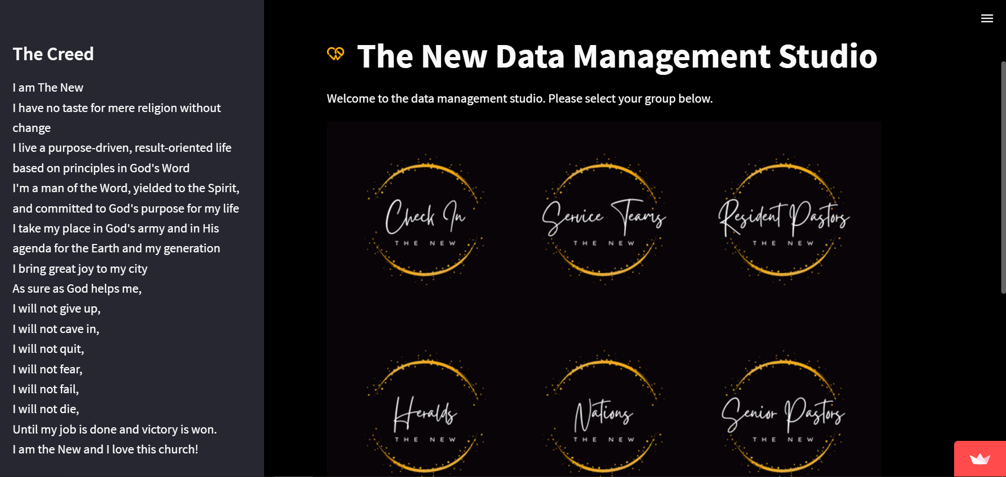
Nations User Manual
Access the portal through https://bit.ly/TheNewDataOps
Works best on a PC; limited functionality on mobile.

Slide 2

Click on Nations.
There are two options:
Nation Pastors for nation pastors, and
Nations Pastor for pastor-in-charge of nations.
Select the option that applies to you.
You will be directed to a portal that asks for your login credentials.

Slide 3

Click on Nations.
There are two options:
Nation Pastors for nation pastors, and
Nations Pastor for pastor-in-charge of nations.
Select the option that applies to you.
You will be directed to a portal that asks for your login credentials.

Slide 4
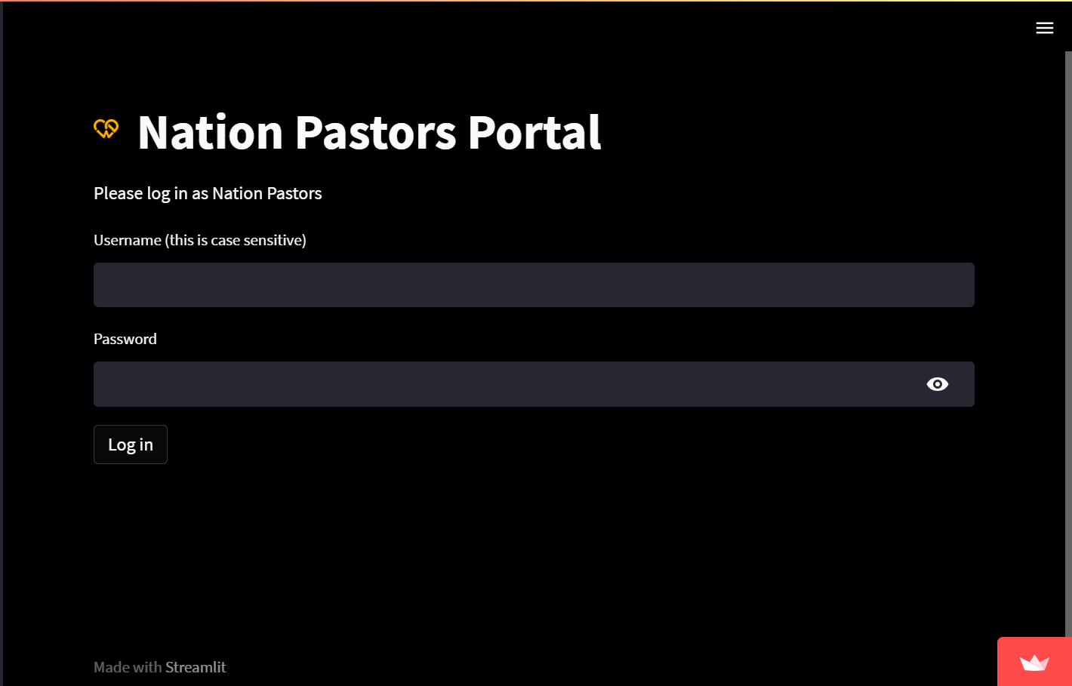
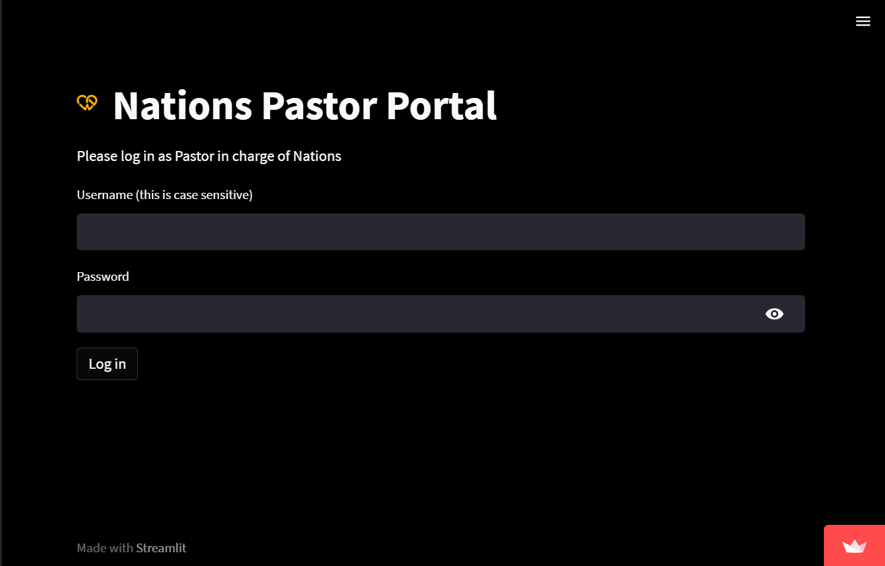
Click on nations.
There are two options:
Nation Pastors for nation pastors, and
Nations Pastor for pastor-in-charge of nations.
Select the option that applies to you.
You will be directed to a portal that asks for your login credentials.

Slide 5
Nation Pastors

Slide 6
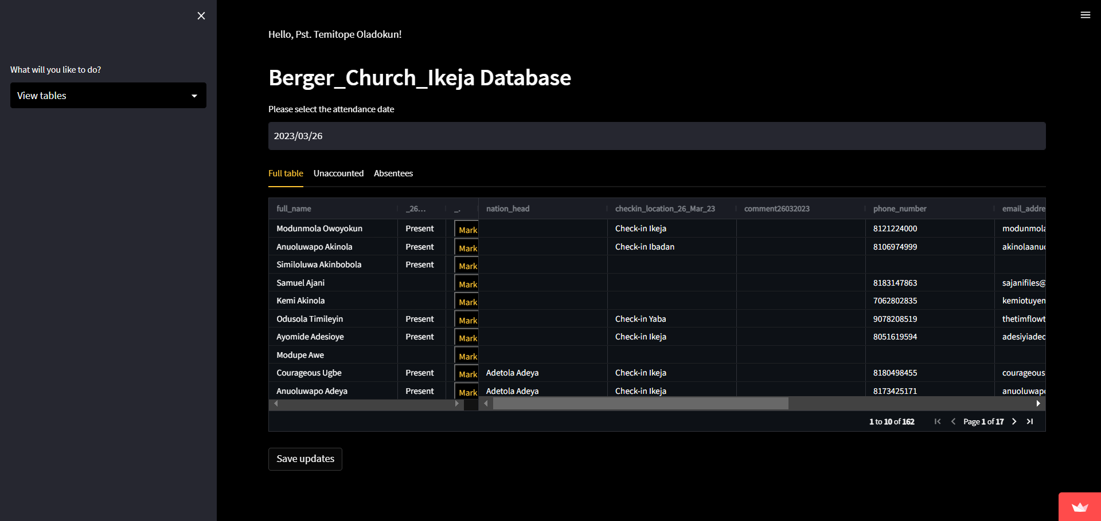
First, select a date that corresponds to a Sunday.
The table with nation members data is loaded with a maximum of 10 people per page. You can see more people by clicking the arrow symbols on the table. Comment column is editable for comments; phone number and email address columns are editable for updates
Second, click on the yellow mark button to mark nation members as either present, absent or blank (unknown).
Click on save table after your session to save your updates. This only shows after an update has been made
Sidebar Options:
View tables
date
save
pages

Slide 7
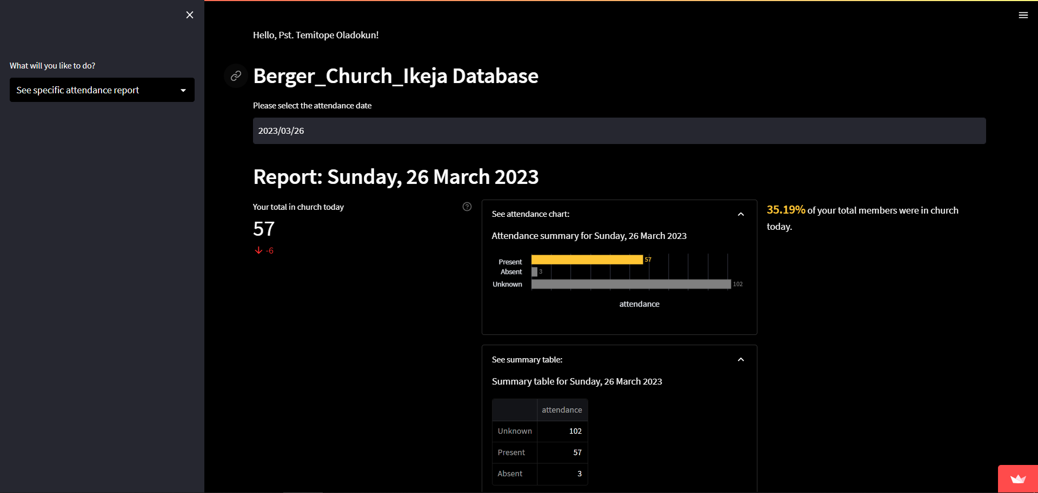
First, select a date that corresponds to a Sunday.
On the left, your total nation members in church for the selected Sunday, with a comparison to last week directly underneath (green arrow is an increase; red is a decrease), is shown.
In the middle, the attendance table and chart is shown in an expandable frame with numbers present, absent and blank (unknown).
On the right, the percentage of attendees is shown. A congratulatory message is displayed if more than 70% of your nation members are present.
Below is a summary paragraph of the statistics.
Sidebar Options:
Attendance report (best viewed on PC)
nation members in church
Expandable frames
nation attendance percentage

Slide 8
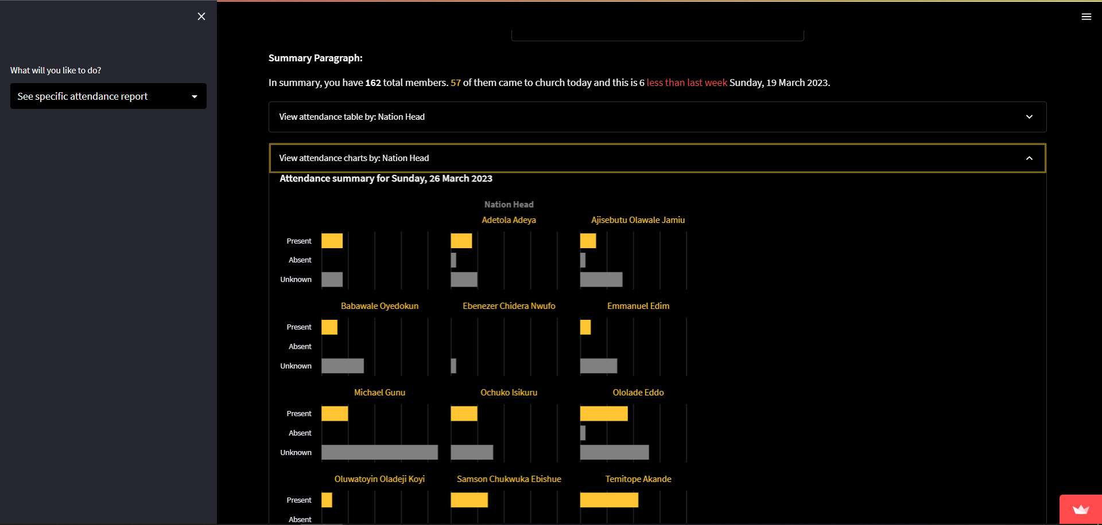
First, select a date that corresponds to a Sunday.
Below is a summary paragraph.
There are also expandable frames that shows you attendance per nation either as tables or charts.
Please alert nation heads where necessary e.g., if most of their nation members are still unaccounted for.
Sidebar Options:
Attendance report (best viewed on PC)

Slide 9
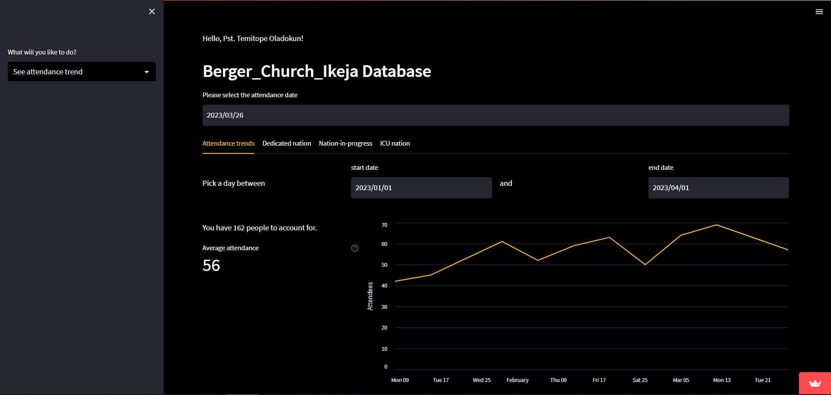
First, select a date that corresponds to a Sunday.
There are four tabs: attendance trends, dedicated nation, nation-in-progress and ICU nation.
Attendance trends show the number of attendees in your nation over the selected period. On the left, the average attendance over that period is shown. There is also an expandable frame that shows attendance trends per nation.
Dedicated nation counts people in each nation with more than 70% attendance each.
nation-in-progress counts people in each nation with 50 to 70% attendance each.
ICU nation counts people in each nation with less than 50% attendance each.
Please pay extra care and attention to your nation in progress and ICU nation.
Sidebar Options:
Attendance trends (best viewed on PC)
Selected period
Average attendance over selected period

Slide 10
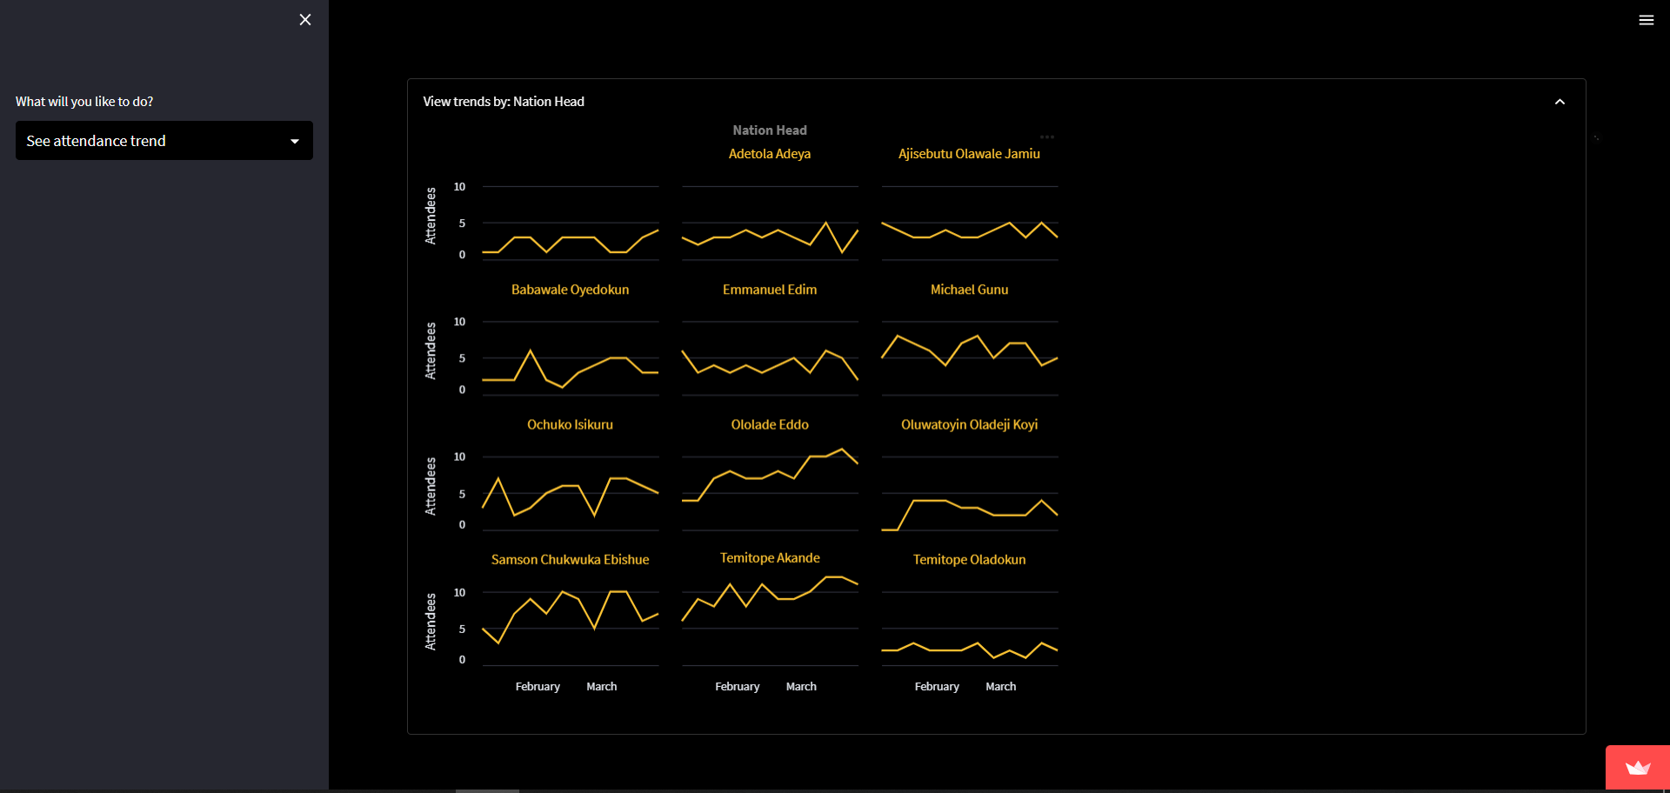
First, select a date that corresponds to a Sunday.
There are four tabs: attendance trends, dedicated nation, nation-in-progress and ICU nation.
Attendance trends show the number of attendees in your nation over the selected period. On the left, the average attendance over that period is shown. There is also an expandable frame that shows attendance trends per nation.
Dedicated nation counts people in each nation with more than 70% attendance each.
nation-in-progress counts people in each nation with 50 to 70% attendance each.
ICU nation counts people in each nation with less than 50% attendance each.
Please pay extra care and attention to your nation in progress and ICU nation.
Sidebar Options:
Attendance trends (best viewed on PC)

Slide 11
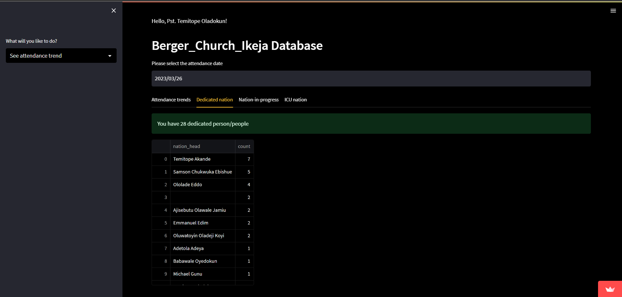
First, select a date that corresponds to a Sunday.
On the left, your total nation members in church for the selected Sunday, with a comparison to last week directly underneath (green arrow is an increase; red is a decrease), is shown.
In the middle, the attendance table and chart is shown in an expandable frame with numbers present, absent and blank (unknown).
On the right, the percentage of attendees is shown. A congratulatory message is displayed if more than 70% of your nation members are present.
Below is a summary paragraph of the statistics.
Sidebar Options:
Attendance trends (best viewed on PC)

Slide 12
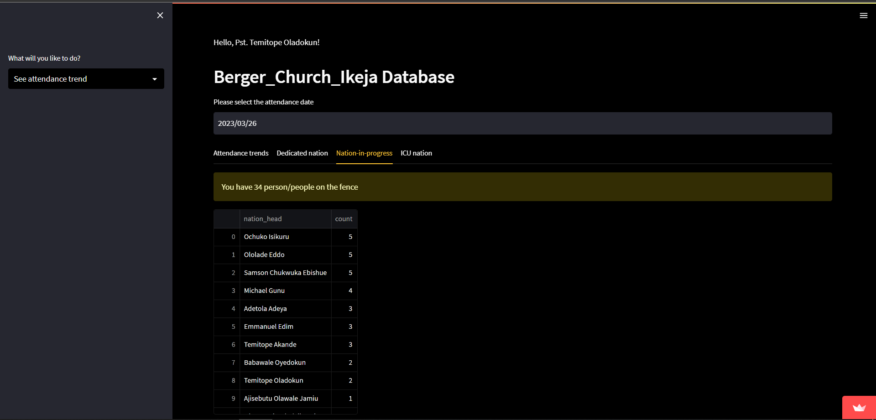
First, select a date that corresponds to a Sunday.
On the left, your total nation members in church for the selected Sunday, with a comparison to last week directly underneath (green arrow is an increase; red is a decrease), is shown.
In the middle, the attendance table and chart is shown in an expandable frame with numbers present, absent and blank (unknown).
On the right, the percentage of attendees is shown. A congratulatory message is displayed if more than 70% of your nation members are present.
Below is a summary paragraph of the statistics.
Sidebar Options:
Attendance trends (best viewed on PC)

Slide 13
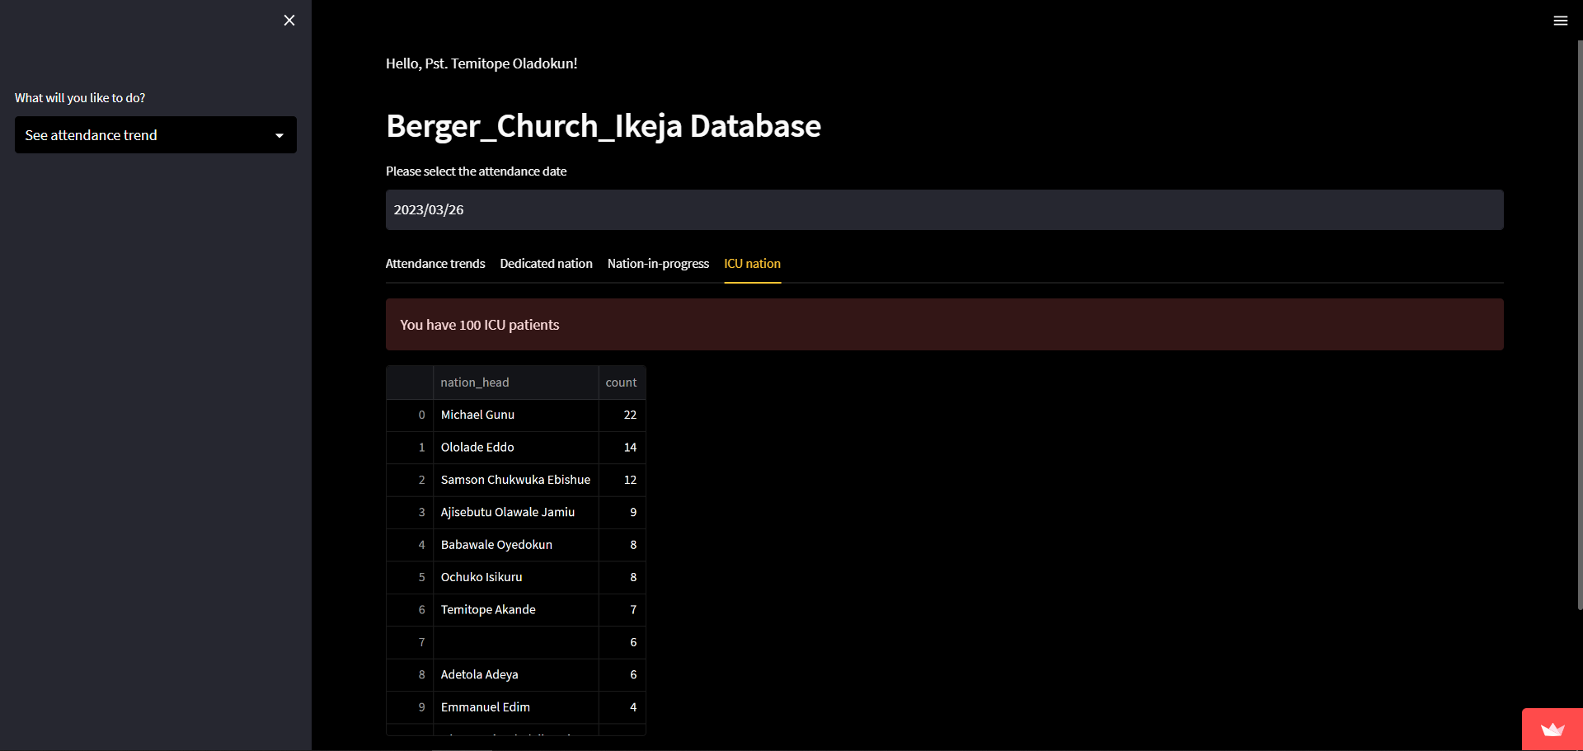
First, select a date that corresponds to a Sunday.
On the left, your total nation members in church for the selected Sunday, with a comparison to last week directly underneath (green arrow is an increase; red is a decrease), is shown.
In the middle, the attendance table and chart is shown in an expandable frame with numbers present, absent and blank (unknown).
On the right, the percentage of attendees is shown. A congratulatory message is displayed if more than 70% of your nation members are present.
Below is a summary paragraph of the statistics.
Sidebar Options:
Attendance trends (best viewed on PC)

Slide 14
Pastor-in-charge (Nations)

Slide 15
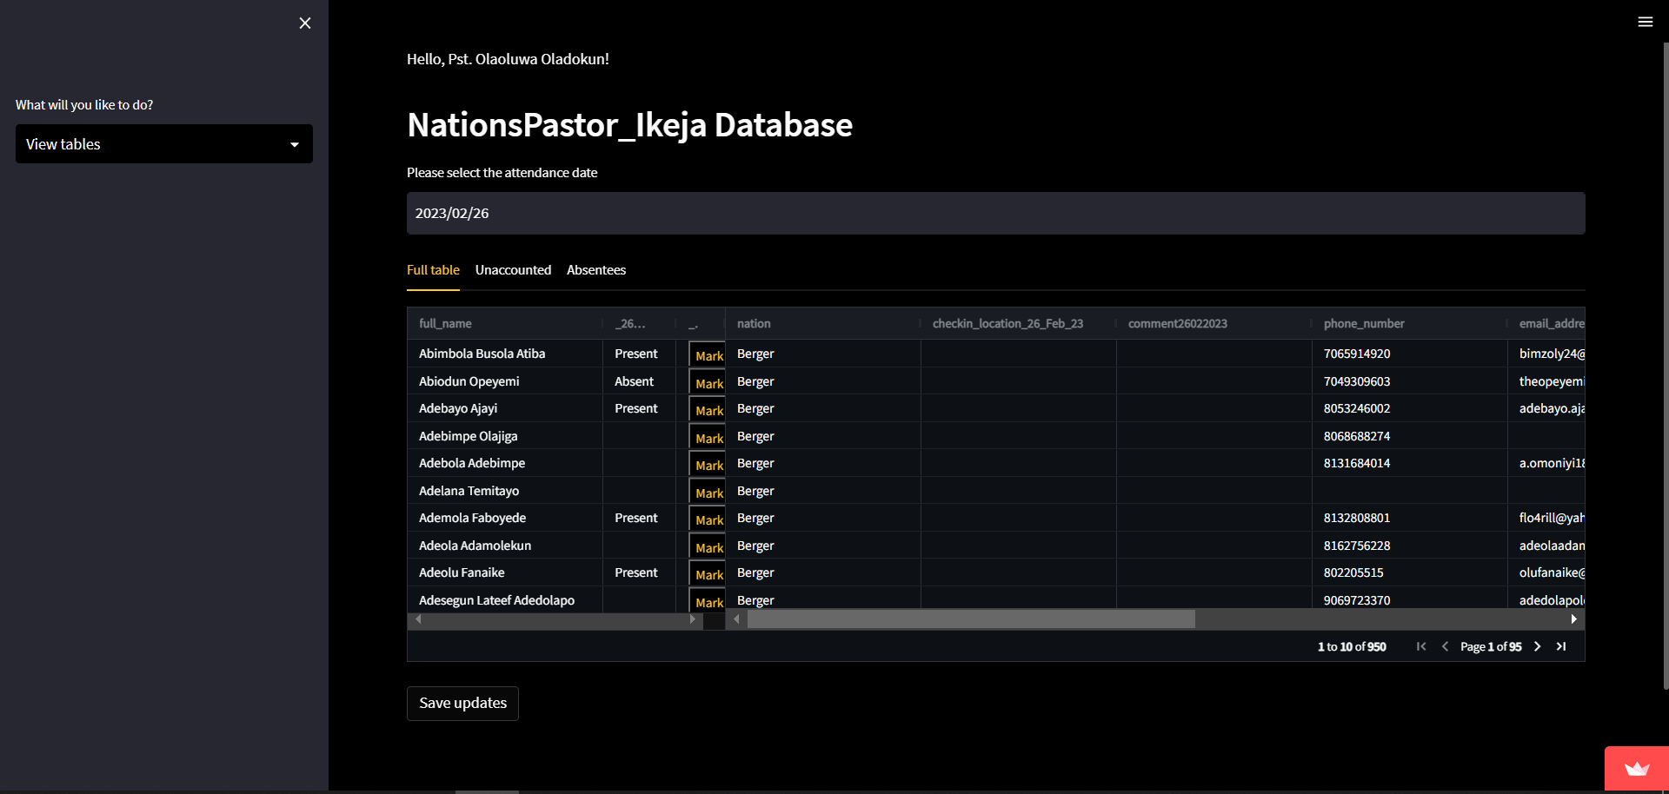
First, select a date that corresponds to a Sunday.
The table with all nation members data is loaded with a maximum of 10 people per page. You can see more people by clicking the arrow symbols on the table. Comments, phone number, and email address columns are editable for updates.
Second, click on the yellow mark button to mark nation members as either present, absent or blank (unknown). Alternatively, you can alert the nation head.
Click on save table after your session to save your updates. This only shows after an update has been made
Sidebar Options:
View tables
date
save
pages

Slide 16
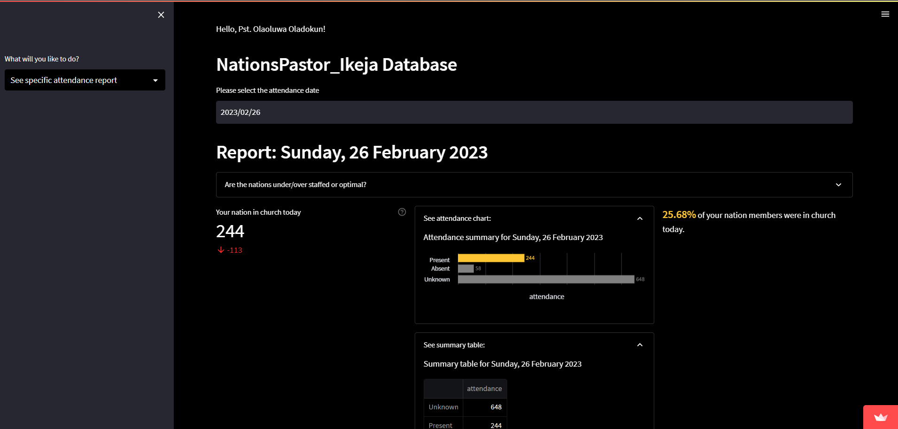
First, select a date that corresponds to a Sunday.
On the left, your total nation members in church for the selected Sunday, with a comparison to last week directly underneath (green arrow is an increase; red is a decrease), is shown.
In the middle, the attendance table and chart is shown in an expandable frame with numbers present, absent and blank (unknown).
On the right, the percentage of attendees is shown. A congratulatory message is displayed if more than 70% of your nation members are present.
Sidebar Options:
Attendance report (best viewed on PC)
nation members in church
Expandable frames
nation attendance percentage

Slide 17
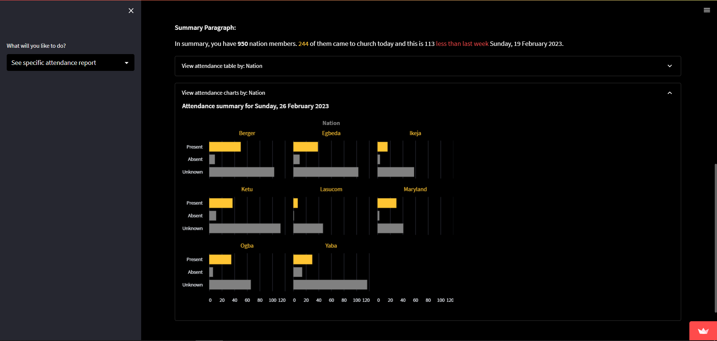
First, select a date that corresponds to a Sunday.
Below is a summary paragraph.
There are also expandable frames that shows you attendance per nation either as tables or charts.
Please alert nation heads where necessary e.g., if most of their nation members are still unaccounted for.
Sidebar Options:
Attendance report (best viewed on PC)

Slide 18
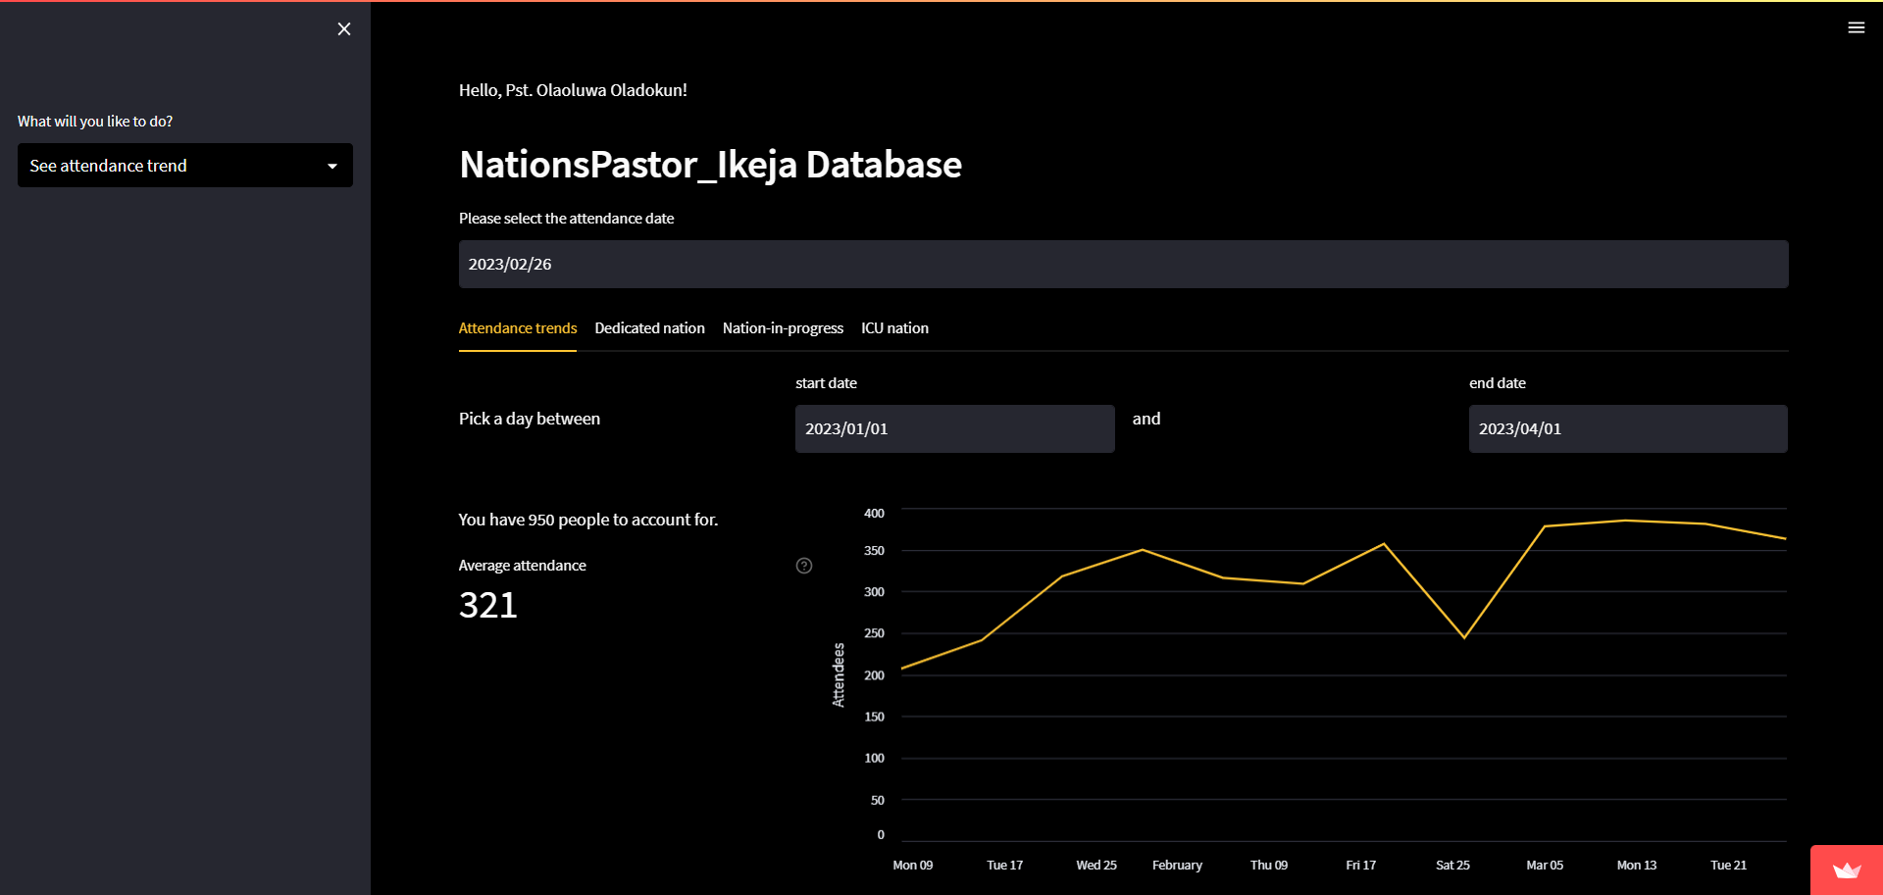
First, select a date that corresponds to a Sunday.
There are four tabs: attendance trends, dedicated nation, nation-in-progress and ICU nation.
Attendance trends show the number of attendees in your nation over the selected period. On the left, the average attendance over that period is shown. There is also an expandable frame that shows attendance trends per nation.
Dedicated nation counts people in each nation with more than 70% attendance each.
nation-in-progress counts people in each nation with 50 to 70% attendance each.
ICU nation counts people in each nation with less than 50% attendance each.
Please pay extra care and attention to your nation in progress and ICU nation.
Sidebar Options:
Attendance trends (best viewed on PC)
Selected period
Average attendance over selected period

Slide 19
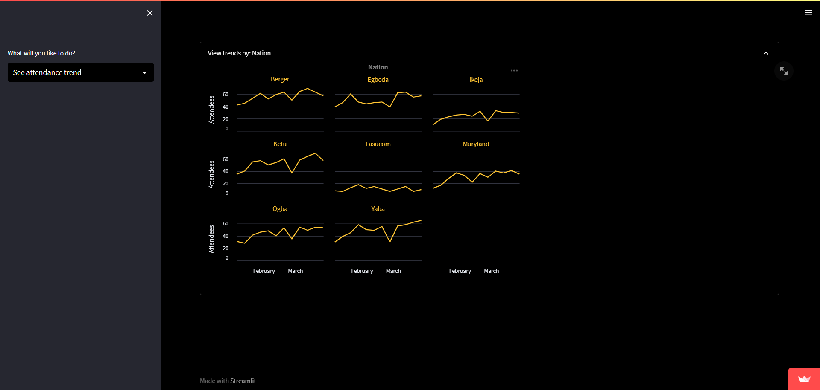
First, select a date that corresponds to a Sunday.
There are four tabs: attendance trends, dedicated nation, nation-in-progress and ICU nation.
Attendance trends show the number of attendees in your nation over the selected period. On the left, the average attendance over that period is shown. There is also an expandable frame that shows attendance trends per nation.
Dedicated nation counts people in each nation with more than 70% attendance each.
nation-in-progress counts people in each nation with 50 to 70% attendance each.
ICU nation counts people in each nation with less than 50% attendance each.
Please pay extra care and attention to your nation in progress and ICU nation.
Sidebar Options:
Attendance trends (best viewed on PC)

Slide 20
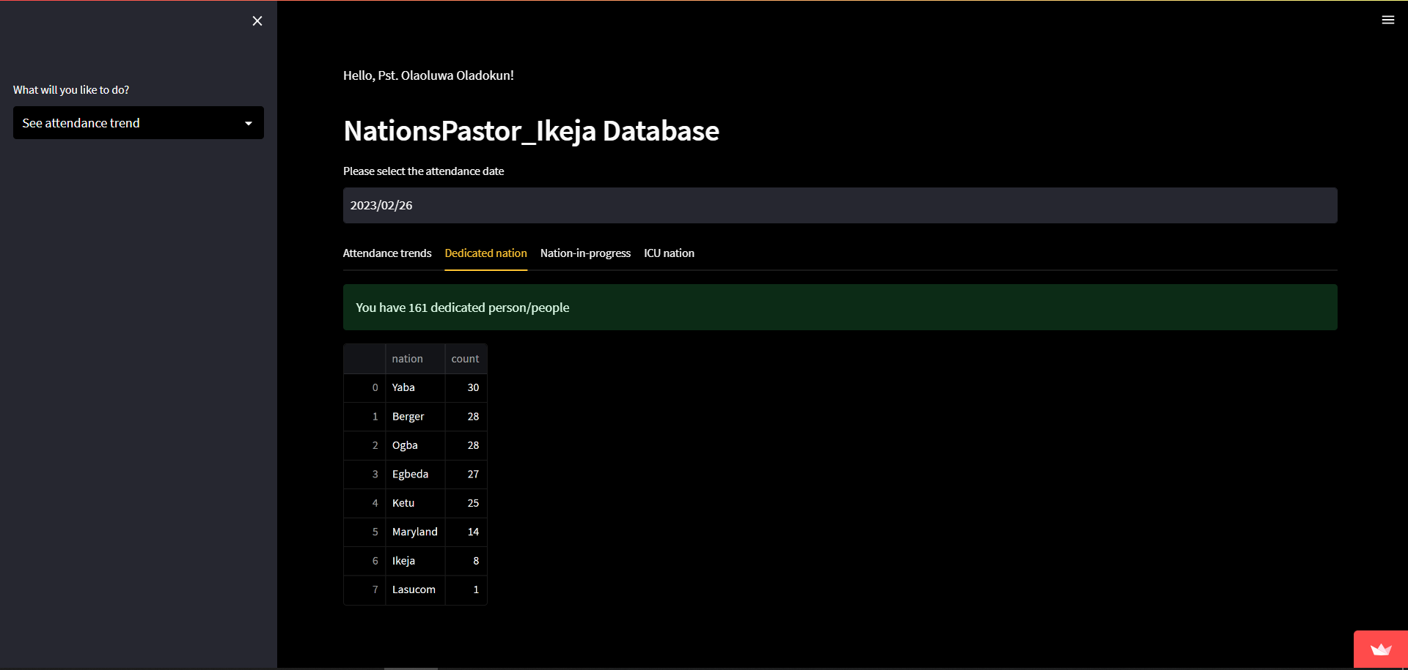
First, select a date that corresponds to a Sunday.
There are four tabs: attendance trends, dedicated nation, nation-in-progress and ICU nation.
Attendance trends show the number of attendees in your nation over the selected period. On the left, the average attendance over that period is shown. There is also an expandable frame that shows attendance trends per nation.
Dedicated nation counts people in each nation with more than 70% attendance each.
nation-in-progress counts people in each nation with 50 to 70% attendance each.
ICU nation counts people in each nation with less than 50% attendance each.
Please pay extra care and attention to your nation in progress and ICU nation.
Sidebar Options:
Attendance trends (best viewed on PC)

Slide 21
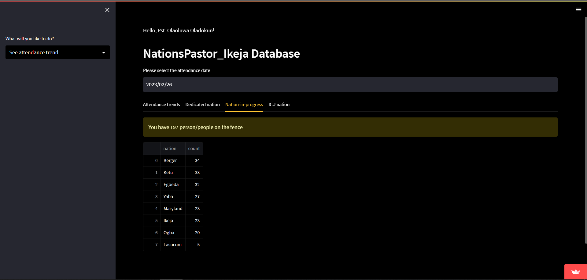
First, select a date that corresponds to a Sunday.
There are four tabs: attendance trends, dedicated nation, nation-in-progress and ICU nation.
Attendance trends show the number of attendees in your nation over the selected period. On the left, the average attendance over that period is shown. There is also an expandable frame that shows attendance trends per nation.
Dedicated nation counts people in each nation with more than 70% attendance each.
nation-in-progress counts people in each nation with 50 to 70% attendance each.
ICU nation counts people in each nation with less than 50% attendance each.
Please pay extra care and attention to your nation in progress and ICU nation.
Sidebar Options:
Attendance trends (best viewed on PC)

Slide 22
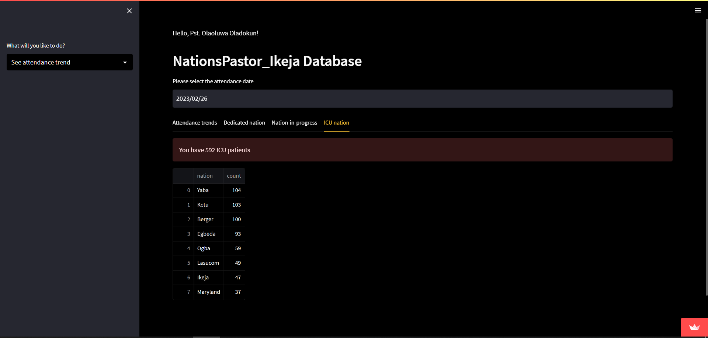
First, select a date that corresponds to a Sunday.
There are four tabs: attendance trends, dedicated nation, nation-in-progress and ICU nation.
Attendance trends show the number of attendees in your nation over the selected period. On the left, the average attendance over that period is shown. There is also an expandable frame that shows attendance trends per nation.
Dedicated nation counts people in each nation with more than 70% attendance each.
nation-in-progress counts people in each nation with 50 to 70% attendance each.
ICU nation counts people in each nation with less than 50% attendance each.
Please pay extra care and attention to your nation in progress and ICU nation.
Sidebar Options:
Attendance trends (best viewed on PC)

Slide 23
Login Credentials

Slide 24
Universal Password is: untilmyjobisdone
Username | nation
PLA | NationsPastor Ikeja
DMJ | Egbeda Church
D_Tolani | Ikeja Church
Daniel | Ogba Church
Leye | Lasucom Church
P_Funke | Yaba Church
P_Matthew | Ketu Church
P_Sope | Maryland Church
P_Tope | Berger Church

Slide 25
Thank You

